Slide 1
Book of Daniel Class 6 – Chapter 5 Winter 2023
What does Daniel instruct Nebuchadnezzar to do in Chapter 4?
What do we learn about Pride in Chapter 4?

Slide 2
Daniel – Rough Outline
Style
Ch 1-6: Story
Ch 7-13: Vision
2. The King’s Dream
7. Daniel’s Dream
3. The Fiery Furnace
6. The Lion’s Den
4. Nebuchadnezzar’s Pride
5. Belshazzar’s Pride
8. Daniel’s 2nd Vision
1. Recruited to Serve in Babylon
9. Daniel’s Prayer
10-12. Daniel’s 3rd Vision
HEBREW
ARAMAIC
HEBREW

Slide 3
The Book of Daniel (Structure)
Style:
Ch. 1-6: Story
Ch. 7-12: Vision
Ch. 1 Hebrew
Ch. 2-7
Aramaic
Ch. 8-12
Hebrew
Language:
Prologue
God rules in the kingdoms of man.
God preserves His sacred people.
Theme:

Slide 4
Daniel 5
Let’s read the text together…

Slide 5
Daniel 5: 1-12 The Writing on the Wall
Who is Belshazzar?
What did they use at the party?
Who did they praise?
Is this the first divine “being” in the story?
Who called for Daniel?

Slide 6
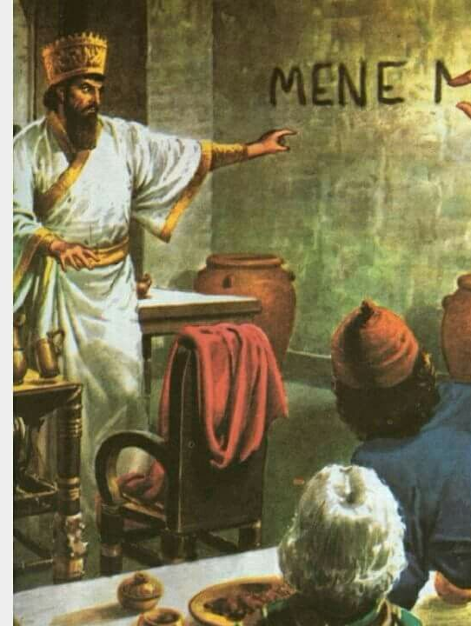
Daniel 5- Mene,Mene, Tekel, Parsin
How old is Daniel in comparison to the story so far?
What roles had Daniel played over the course of time?
How had he watched leaders behave in his vast experience?
How deep into the exile are the captives?
What was the message?
What happened that night?

Slide 7
What is our lesson from Daniel 5?
Class Discussion
Pride
Warning of coming destruction?
Daniel 4:27
2 Kings 20:1-4
James 1:12
Matthew 24:36-39

Slide 8
The Book of Daniel
Homework: Chapter 6

Slide 9
Daniel: Class Schedule
Date | Class | Teacher
Sun 12/3 | Class Introduction & Background | Robert McDonald
Sun. 12/10 | Chapter 1 | Robert McDonald
Sun. 12/17 | Chapter 2 | H.E. Jenkins
Sun. 12/24 | Chapter 3 | Robert McDonald
Sun. 12/31 | Chapter 4 | H.E. Jenkins
Sun. 1/7 | Chapter 5 | H.E. Jenkins
Sun. 1/14 | Chapter 6 | Robert McDonald
Sun. 1/21 | Chapter 7 | H.E. Jenkins
Sun 1/28 | Chapter 8 | H.E. Jenkins
Sun. 2/4 | Chapter 9 | Robert McDonald
Sun. 2/11 | Chapter 10-11 | Robert McDonald
Sun. 2/18 | Chapter 12 | H.E. Jenkins
Sun. 2/25 | Summary and Themes | H.E. Jenkins

